Slide 1
Presentation
Jiayu Chen
2023.12.12

Slide 2
Work Description
Part_1: A Brief Explanation of the FMM Algorithm
Part_2: Detailed Introduction to the BSG Signal Processing Workflow:
1. Signal Preprocessing
2. Periodic Segmentation and Realignment
3. Template Calculation and Quality Filtering
4. Attempt at Feature Extraction
5. Evaluating the Effectiveness of Feature Extraction for Prediction
Part_3: Attempts based on the given suggestions, including Matched Filter, SG Filter, and differentiation
Part_4: Problems

Slide 3
Part_1

Slide 4
Part_2

Slide 5
Signal Preprocessing
Preprocessing
Segmentation
Realignment
Template
Feature Extraction
Prediction
Problem_1
Problem_2
呼吸到底要不要
从模拟数据中反映出的结果来看
计算Template的算法，至关重要
好的计算Template算法，可以抵消呼吸带来的影响
过滤掉质量差的信号。
Codes implemented by myself from the paper IoT2023
Codes from Yingjian
BCG_Preprocessing.py
太过严格了
4672条信号筛选结束满足条件的大致472条信号
评估策略比我复现出来的代码要松不少
4672信号还剩下4524条信号。
从能够用来预测呼吸和心跳的信号，比能用来提取模板的信号，要更加的杂乱一些。
我和Song老师在上次会议时认为，需要确立合适的标准，再增加一轮的筛选，从而确保信号的质量。
这个筛选的标准，已经解决了，我后面会详细的说
Conclusion
Notes:
之前的通过复现论文“”实现了信号质量检测，并过滤掉质量差的信号。
论文中的过滤方法似乎有一些太过严格了 4672条信号筛选结束满足条件的大致472条信号。
然后拿到了Yingjian学长的源代码，里面的那个质量评估函数。它的评估策略比我复现出来的代码要松不少，4672信号还剩下4524条信号。
我采用了Yingjian的预处理方式。
从能够用来预测呼吸和心跳的信号，比能用来提取模板的信号，要更加的杂乱一些。
我和Song老师在上次会议时认为，需要确立合适的标准，再增加一轮的筛选，从而确保信号的质量。
这个筛选的标准，已经解决了，我后面会详细的说

Slide 6
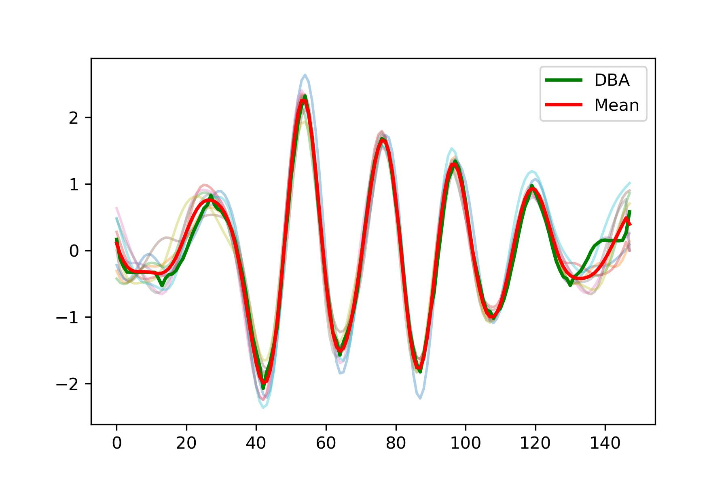
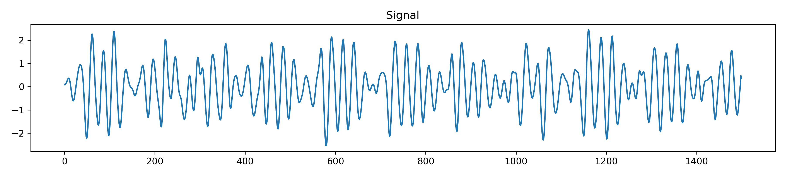
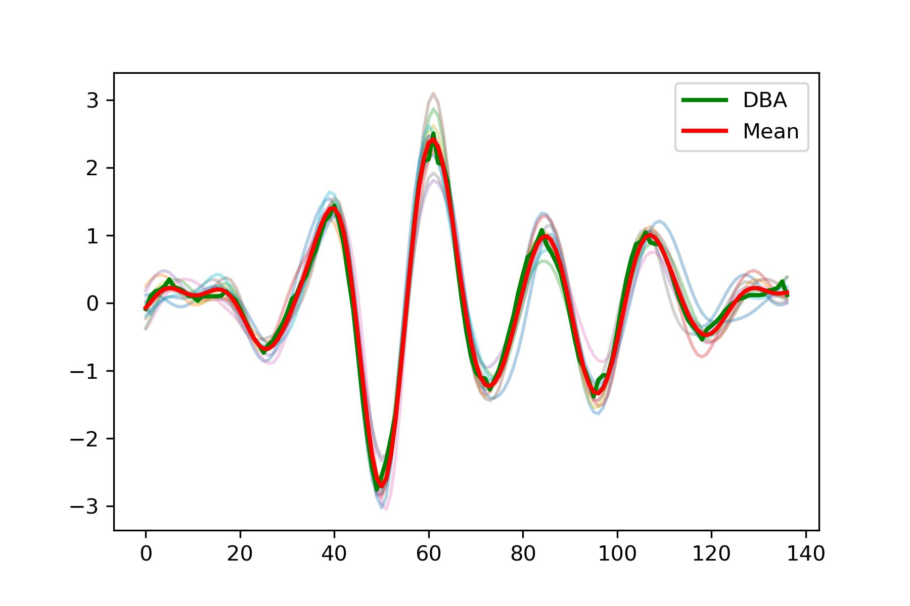
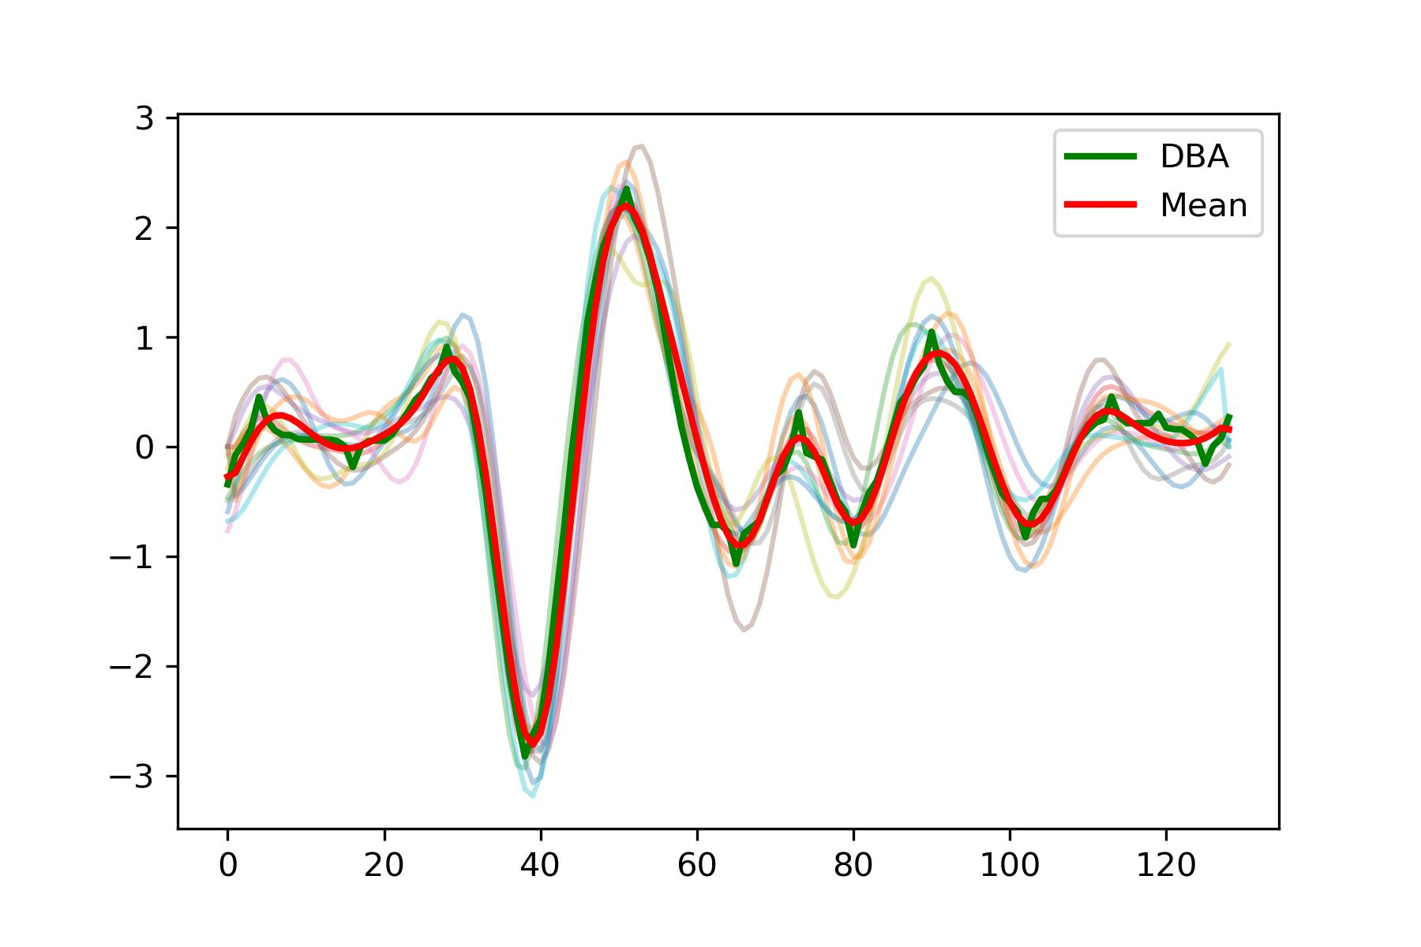
Segmentation
Preprocessing
Segmentation
Realignment
Template
Feature Extraction
Prediction
面临着两个挑战
- Waveforms sometimes resemble SCG, sometimes resemble BCG, and at times fall between the two.
- 是一个多峰的信号，Amplitudes of peaks within each cycle are not consistent. 不像SCG或者ECG信号，有一个固定的主峰
Compared to simulated SCG signals, challenges encountered in real signals are as follows:
The initial section of the signal is often problematic, with periodic incompleteness.
BCG
SCG
Notes:
挑战1意味着我们设计的分割算法，是能使用在不同类型的信号之上
挑战2意味着，不能像通常那样，定位信号中的一个主峰，然后依据主峰进行分割

Slide 7
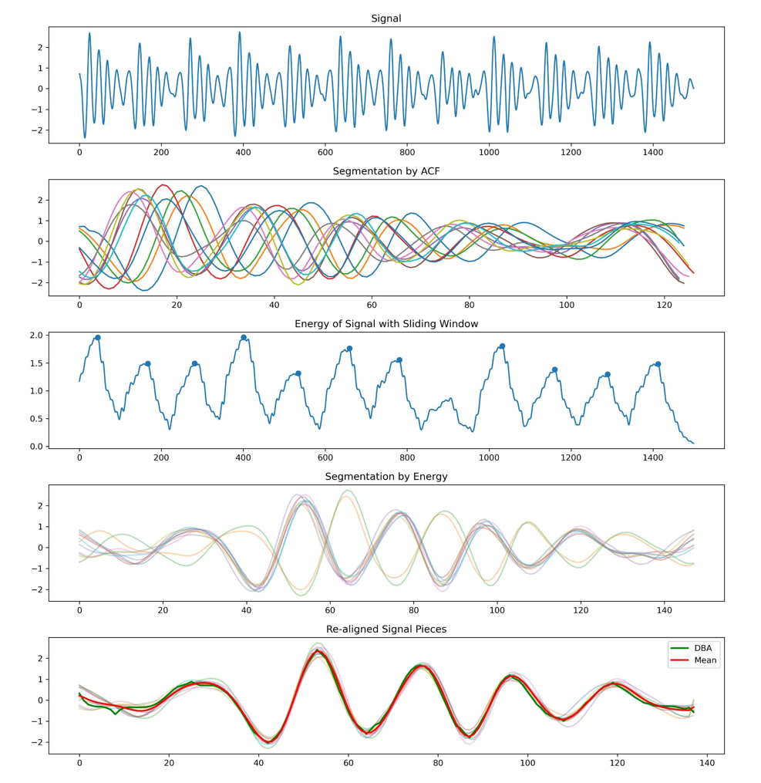
Segmentation
Preprocessing
Segmentation
Realignment
Template
Feature Extraction
Prediction
I attempted to utilize an approach presented by Yingjian Song in IoT2023.
While this method is sufficient for estimating heart rate, it is not adequate for accurate segmentation, leading to the following two issues:
Significant and unmanageable errors, making alignment difficult.
The resulting segments are not the desired cycles after the split.
Signal
Hilbert transform for envelope
ACF
Peak Detection
We get
Savitzky-Golay filter
Segmentation
We want

Slide 8
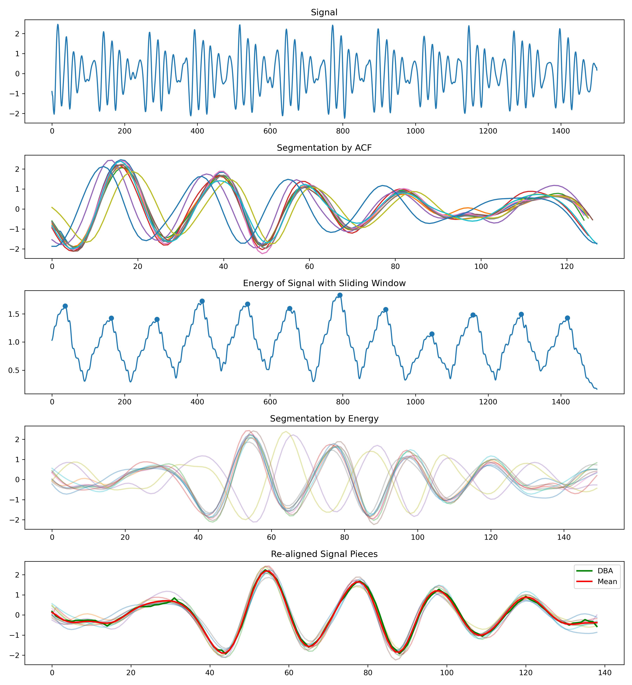
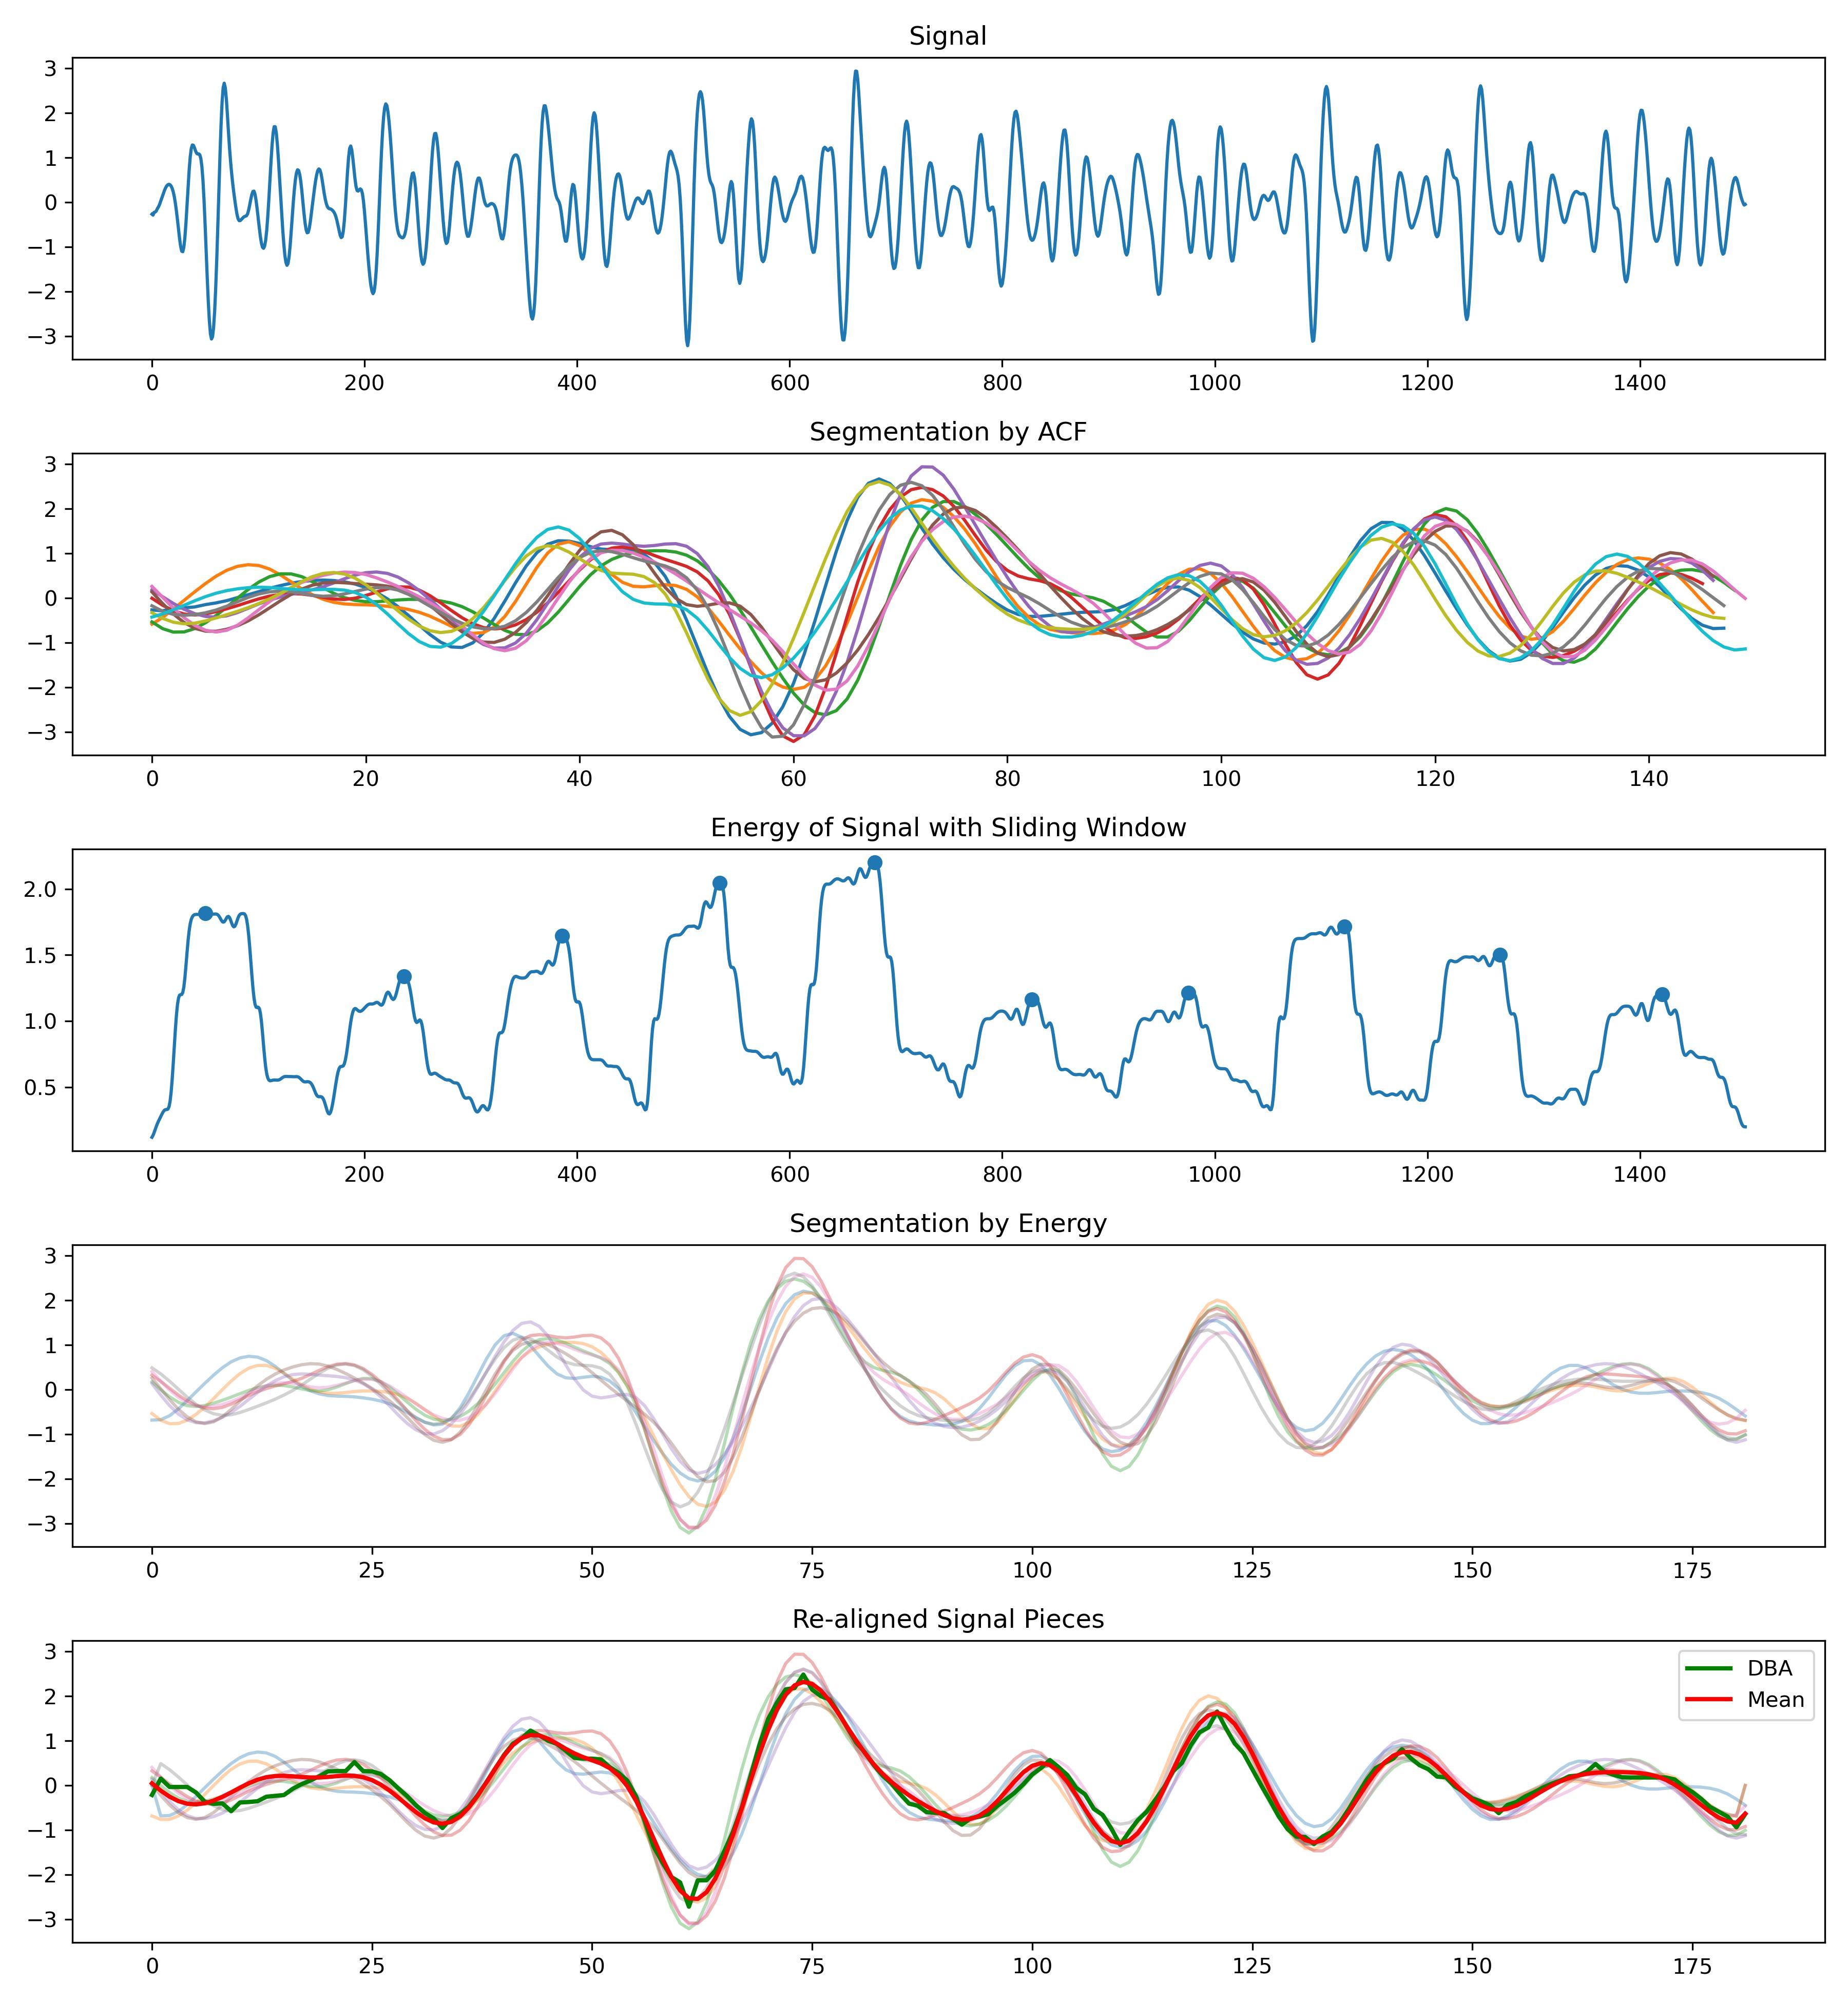
Segmentation
Preprocessing
Segmentation
Realignment
Template
Feature Extraction
Prediction
Solution approach:
Is it possible to transform the multi-peak signal in time domain into a single-peak problem in another domain, and ensure that this single peak is relatively fixed within each cycle?
Upon observation, the distribution of energy density within a single cycle of the signal is often relatively stable.
Transforming the multi-peak signal in the time domain into a single-peak problem in the energy density domain.
Notes:
与希尔伯特变化所取的包络线相比，这种方法有一个非常明确的物理含义，对于某一类周期信号，每个周期中能量集中的位置，是相对稳定的

Slide 9
Re-alignment
Preprocessing
Segmentation
Realignment
Template
Feature Extraction
Prediction
The distribution of energy density is often relatively stable, but not completely identical.
To enhance precision, it is necessary to re-align the signals that have already been segmented.
Linear Alignment -> O(T)
Linear Realignment
Acceptable
Without phase variation
Non-Linear Alignment -> O(T^2)
One-circle pieces
With phase variation
Non-Linear Realignment
Unacceptable
There is no need for us.

Slide 10
Re-alignment
Preprocessing
Segmentation
Realignment
Template
Feature Extraction
Prediction
Start
Choose one piece x from N pieces X
Cross Correlation between x and X[1]
Cross Correlation between x and X[N-1]
Add the Cross Correlation results from N-1 times
Find the appropriate time unit for lag.
Time complexity O(N^3), where N represents the average length of a single cycle.
This algorithm is guaranteed to converge.
Realign piece x.
Re-aligned pieces

Slide 11
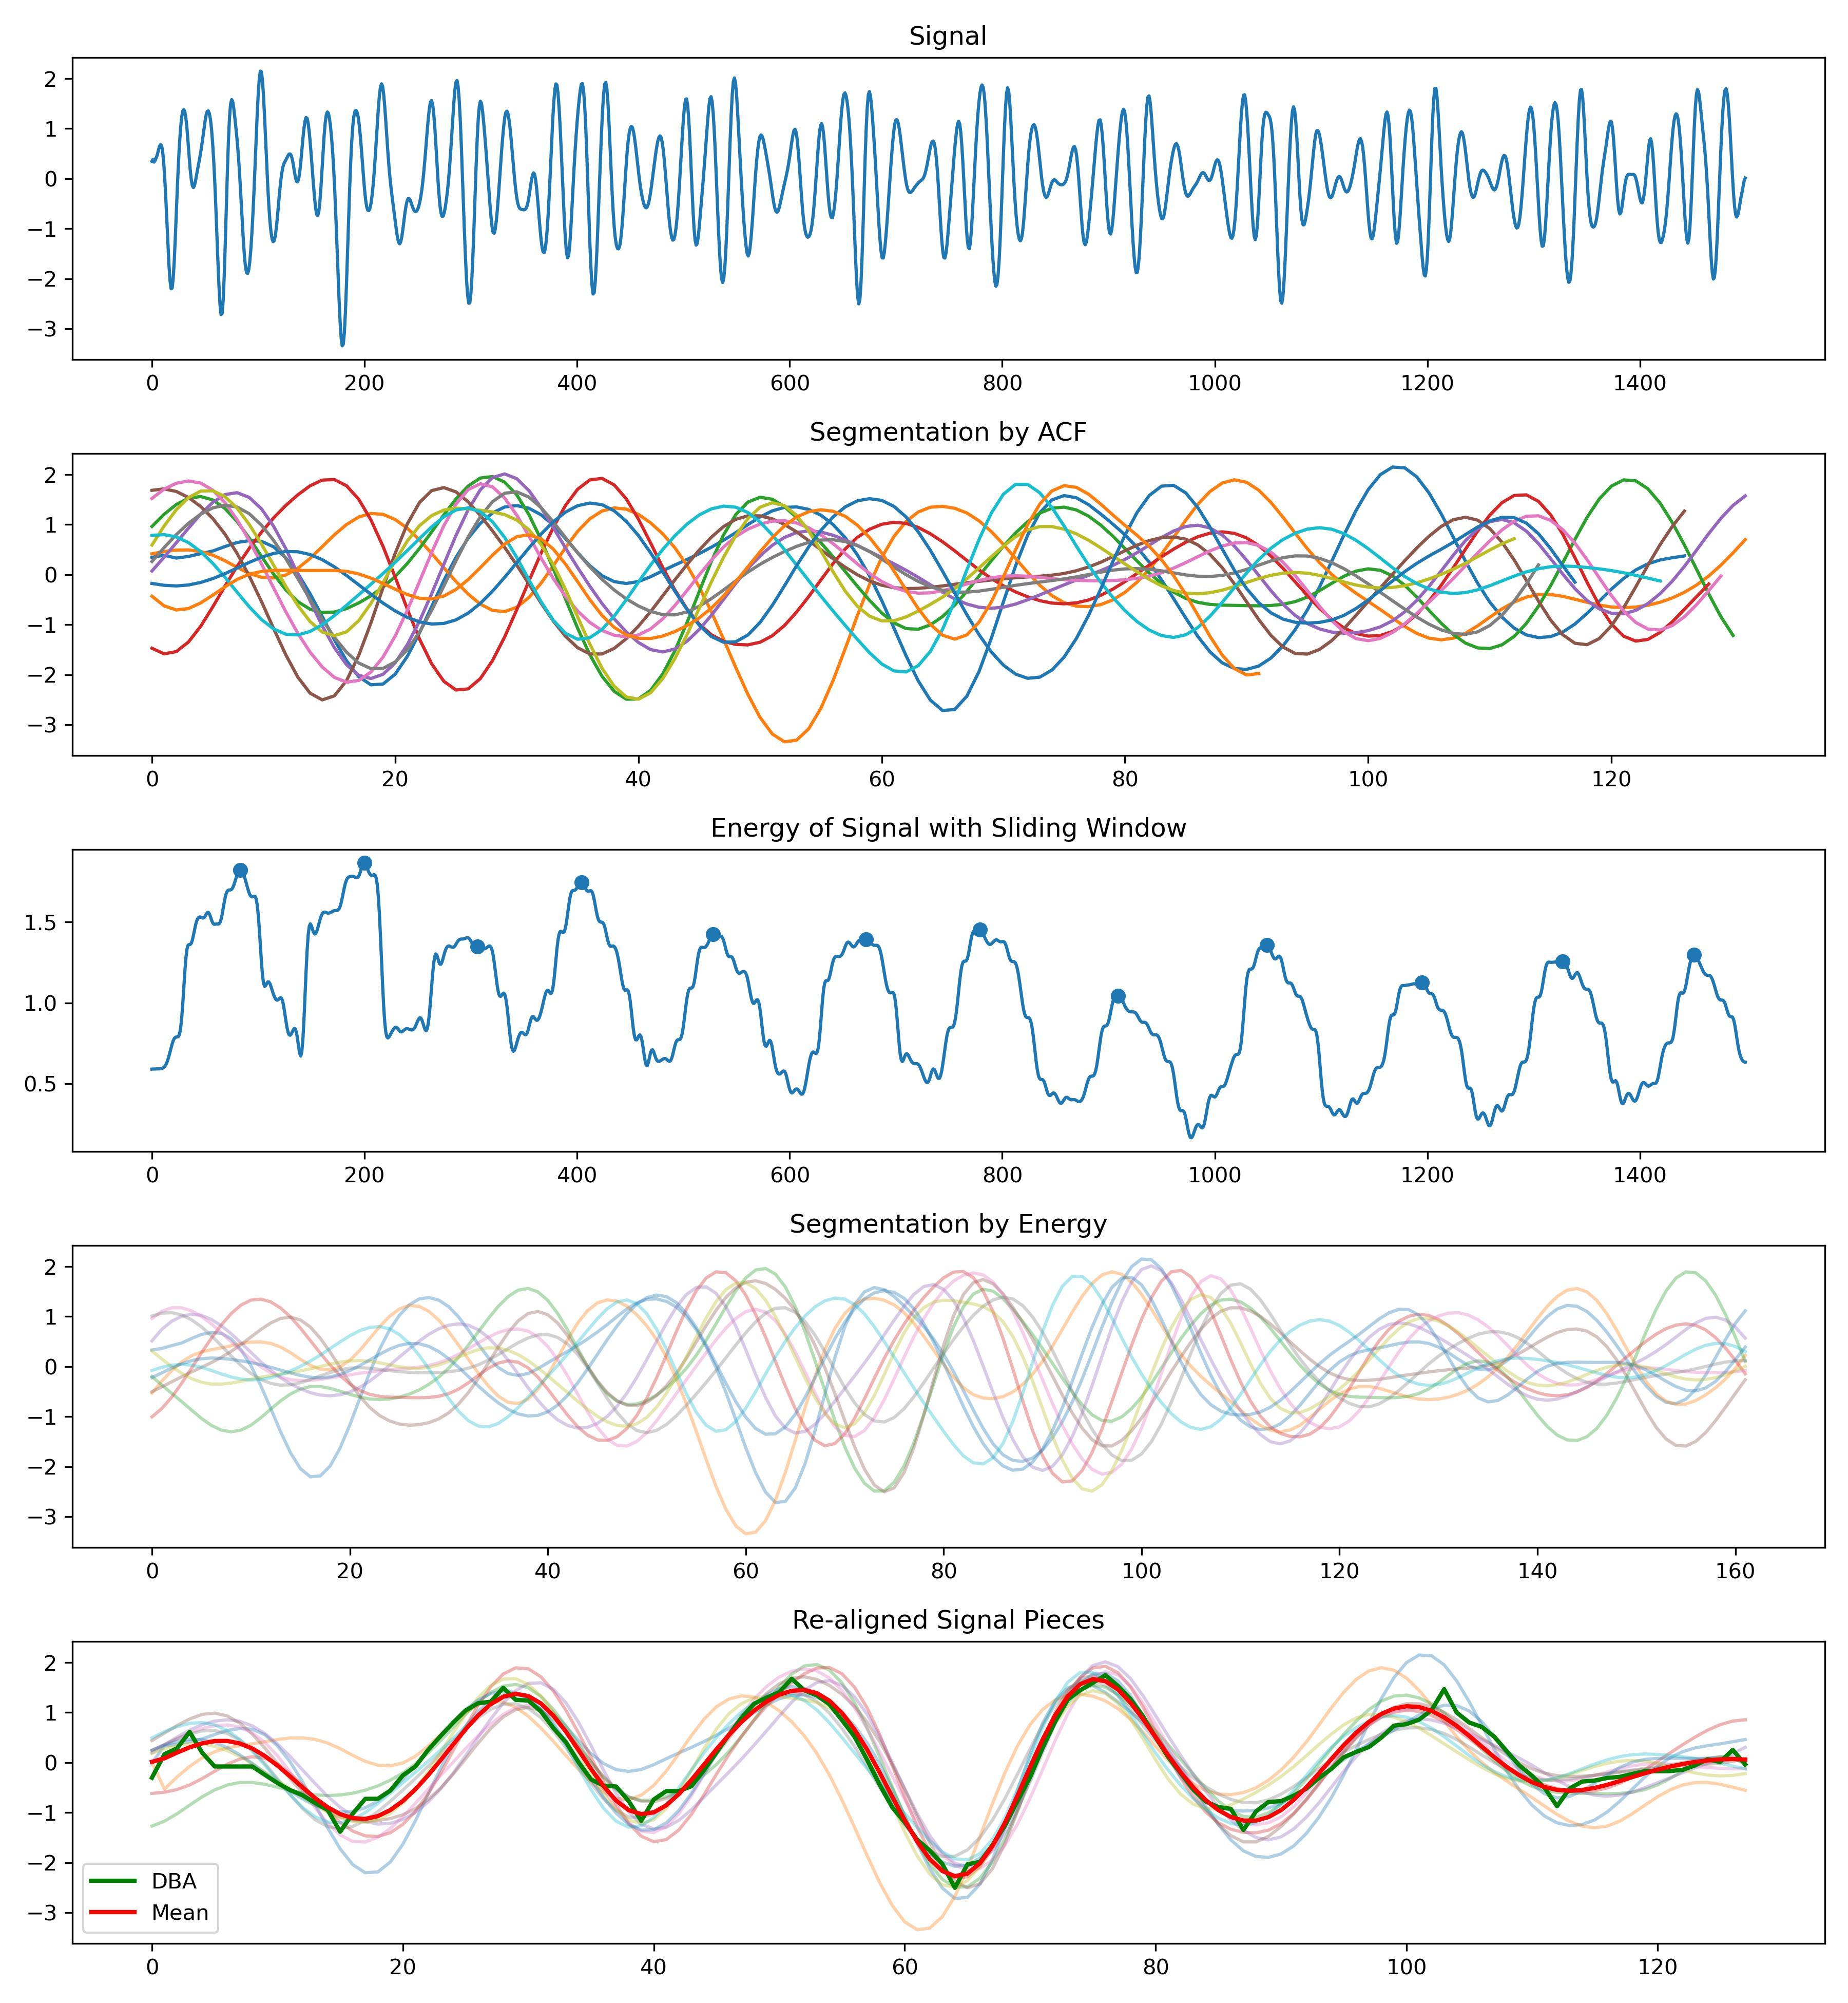
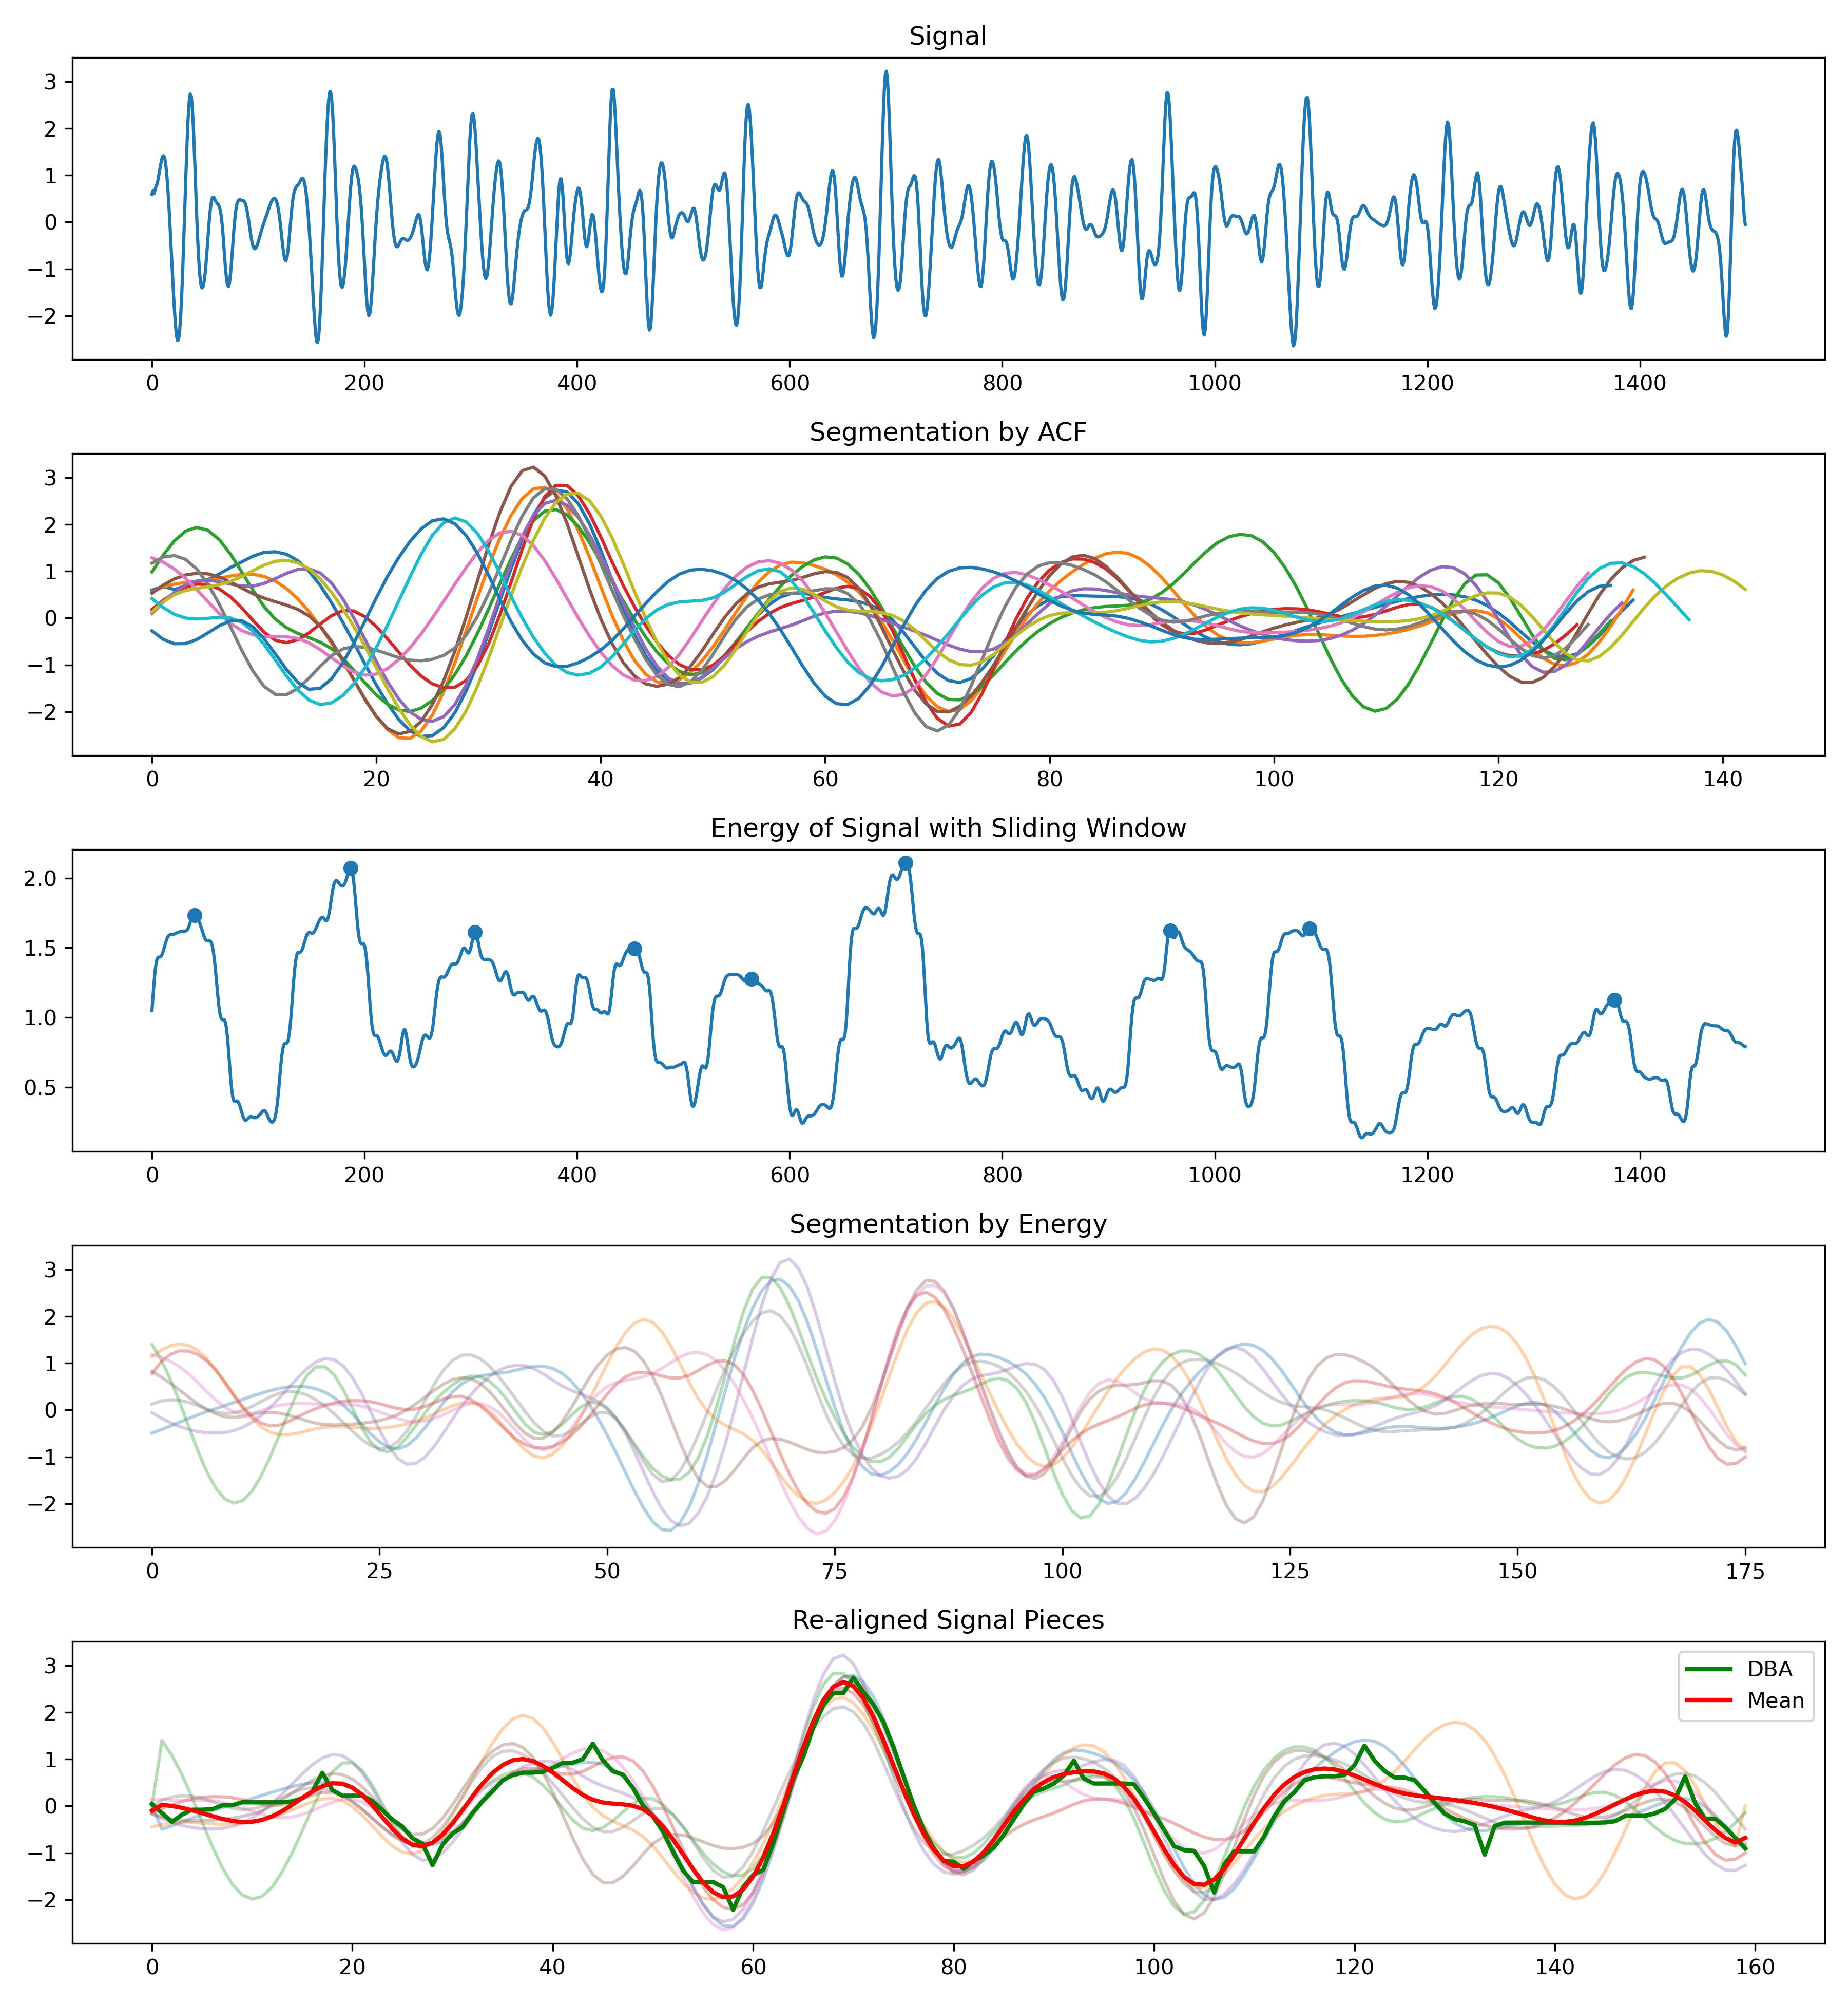
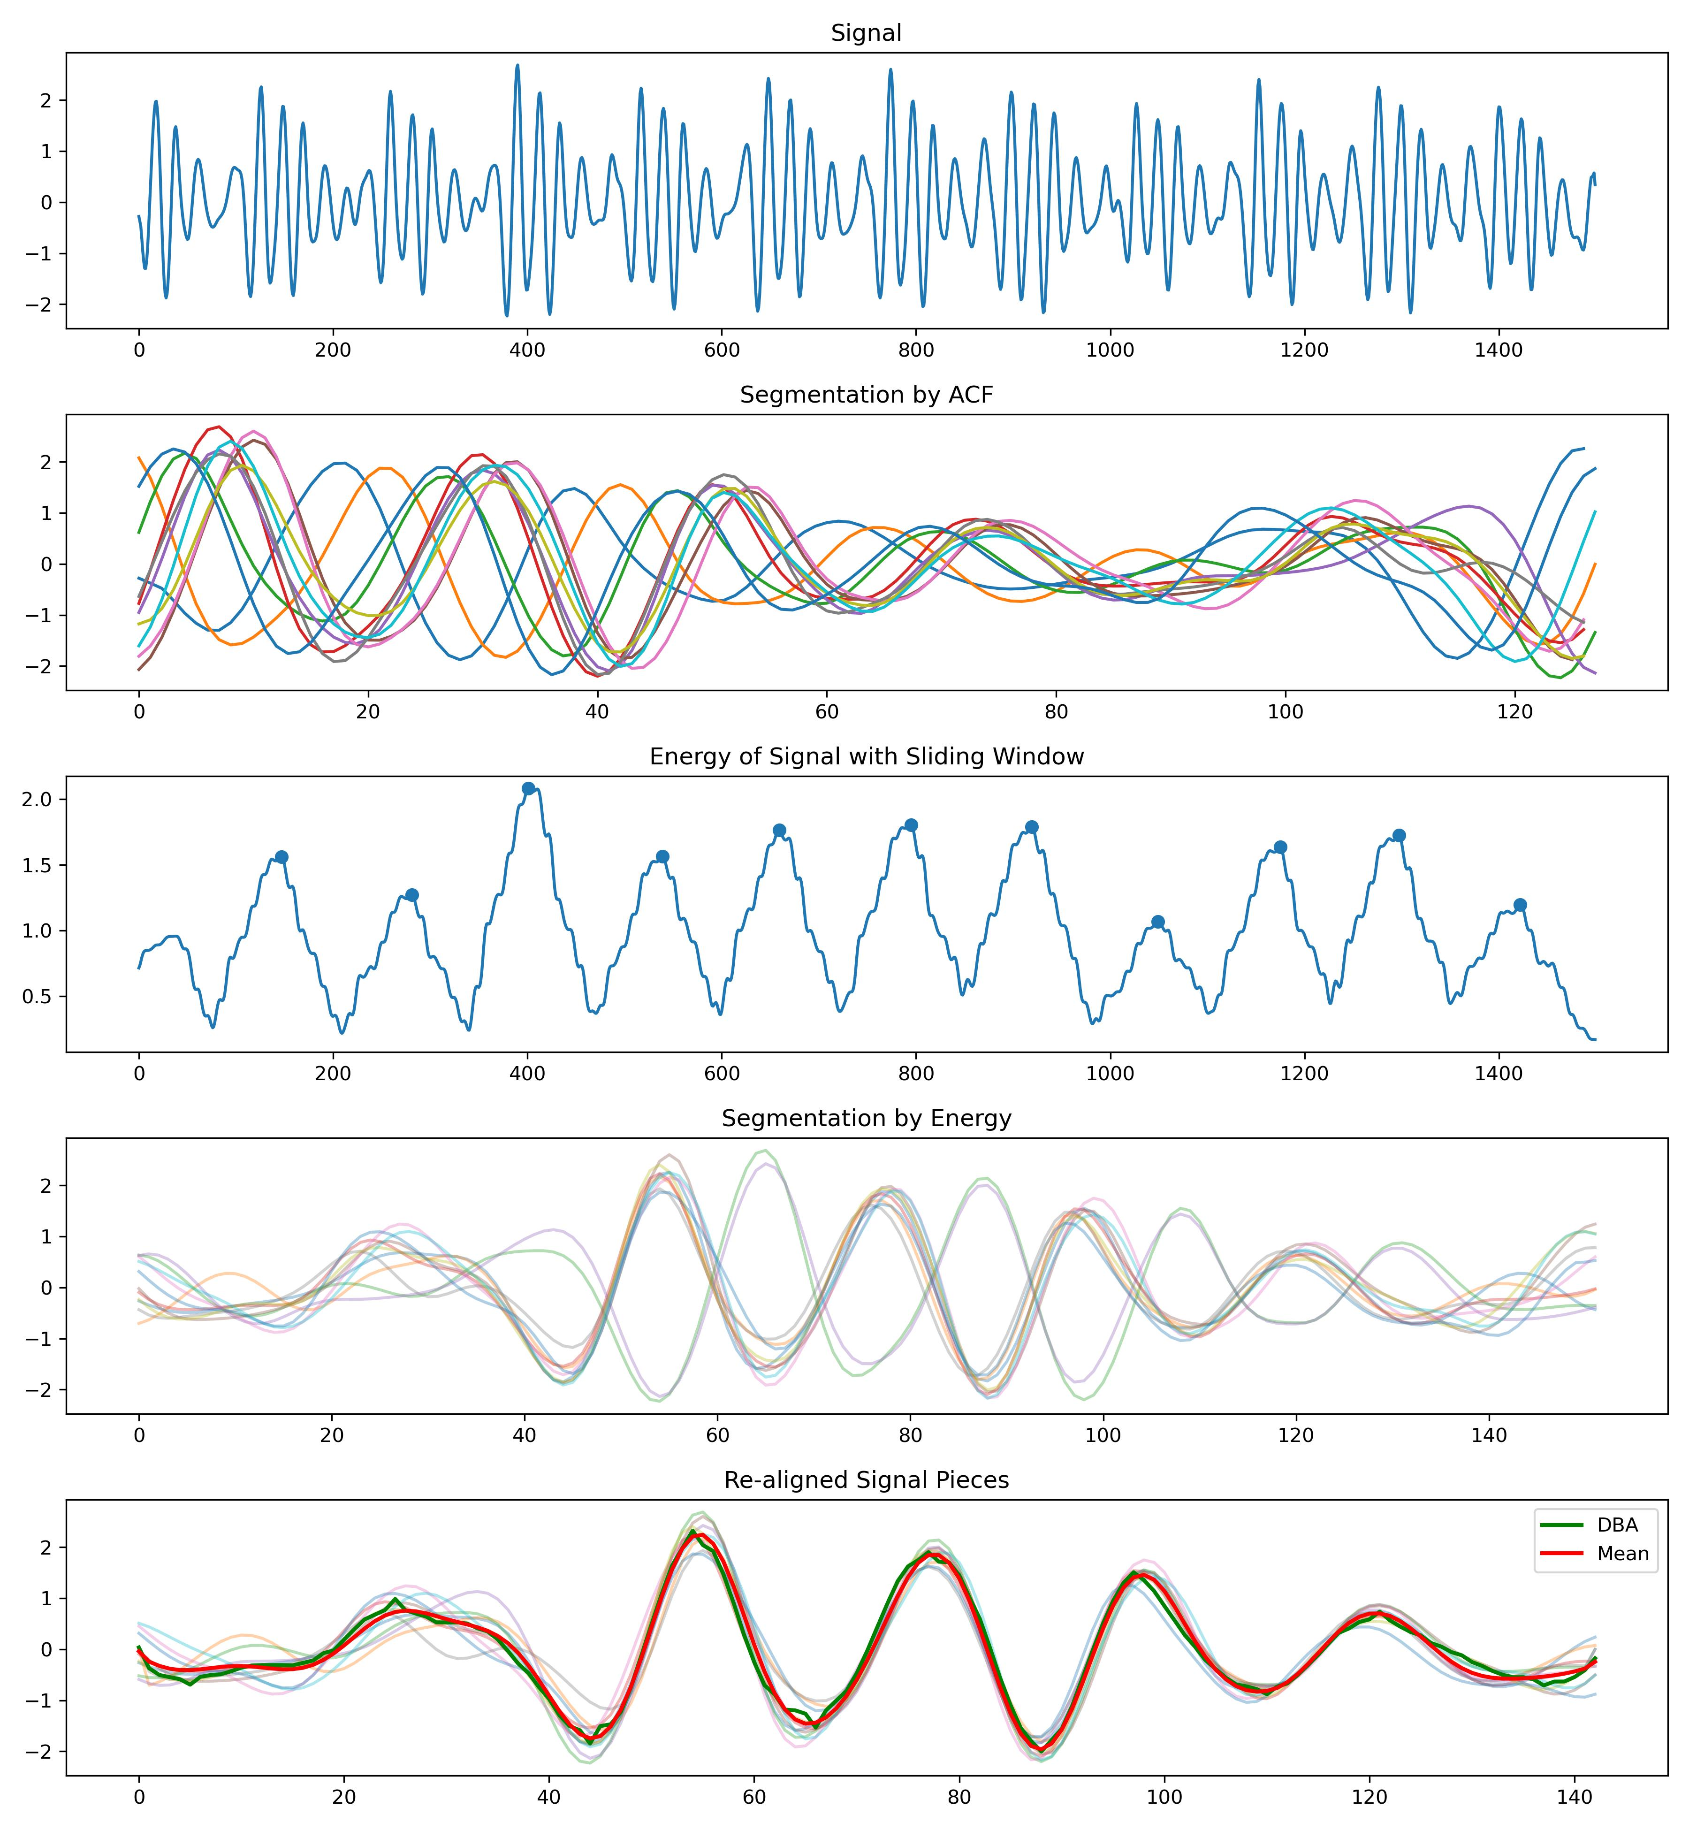
Re-alignment
Preprocessing
Segmentation
Realignment
Template
Feature Extraction
Prediction
More Figures can be found here:
https://github.com/A-Big-Tortoise/Presentation/tree/main/Pics/Segmentation

Slide 12
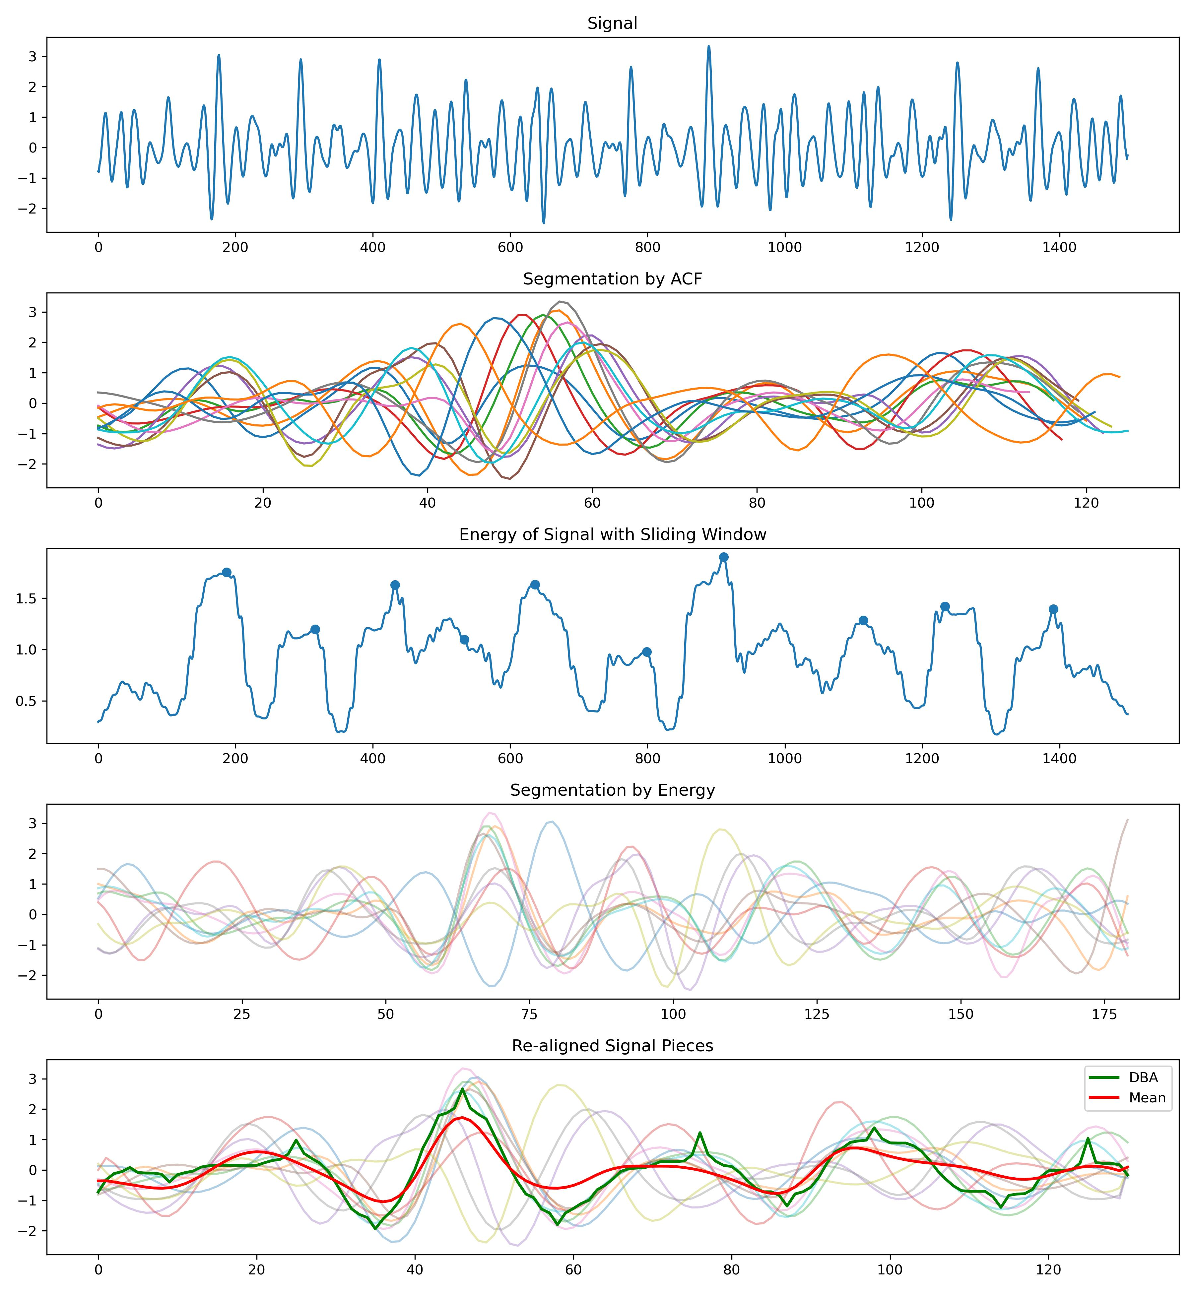
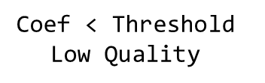
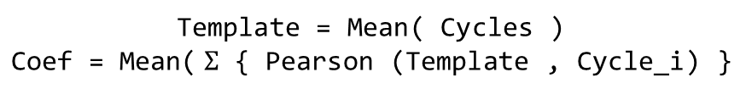
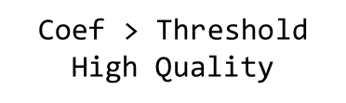
Template and its Quality
Preprocessing
Segmentation
Realignment
Template
Feature Extraction
Prediction
What kind of signal can extract high-quality template?
对于提取Template这个任务而言，这段信号是不是高质量的呢
Can we check the quality of signals before obtaining the template?
Yes
No
How to eliminate some bad cycles?
Statistical measurement
Experience-based strategy
If … Else
How to assess whether a template is good or not?
Whether the re-alignment is successful can be used to assess the quality of the template.
Template = Mean( Cycles )
$$\text{Coef}\text{ = }\text{Mean}\text{(} Σ \text{\{ }\text{Pearson}\text{ (}\text{Template}\text{ , }\text{Cycle}\text{_}\text{i}\text{) \}}$$
$\text{Coef}$ < Threshold
Low Quality
$\text{Coef}$ > Threshold
High Quality
https://github.com/A-Big-Tortoise/Presentation/tree/main/Pics/QualityAssessment4Template
Notes:
这个问题能不能在信号预处理的时候解决？
每个周期之间差异很大
进一步处理，删除掉一些差异很大的周期，进一步过滤信号

Slide 13
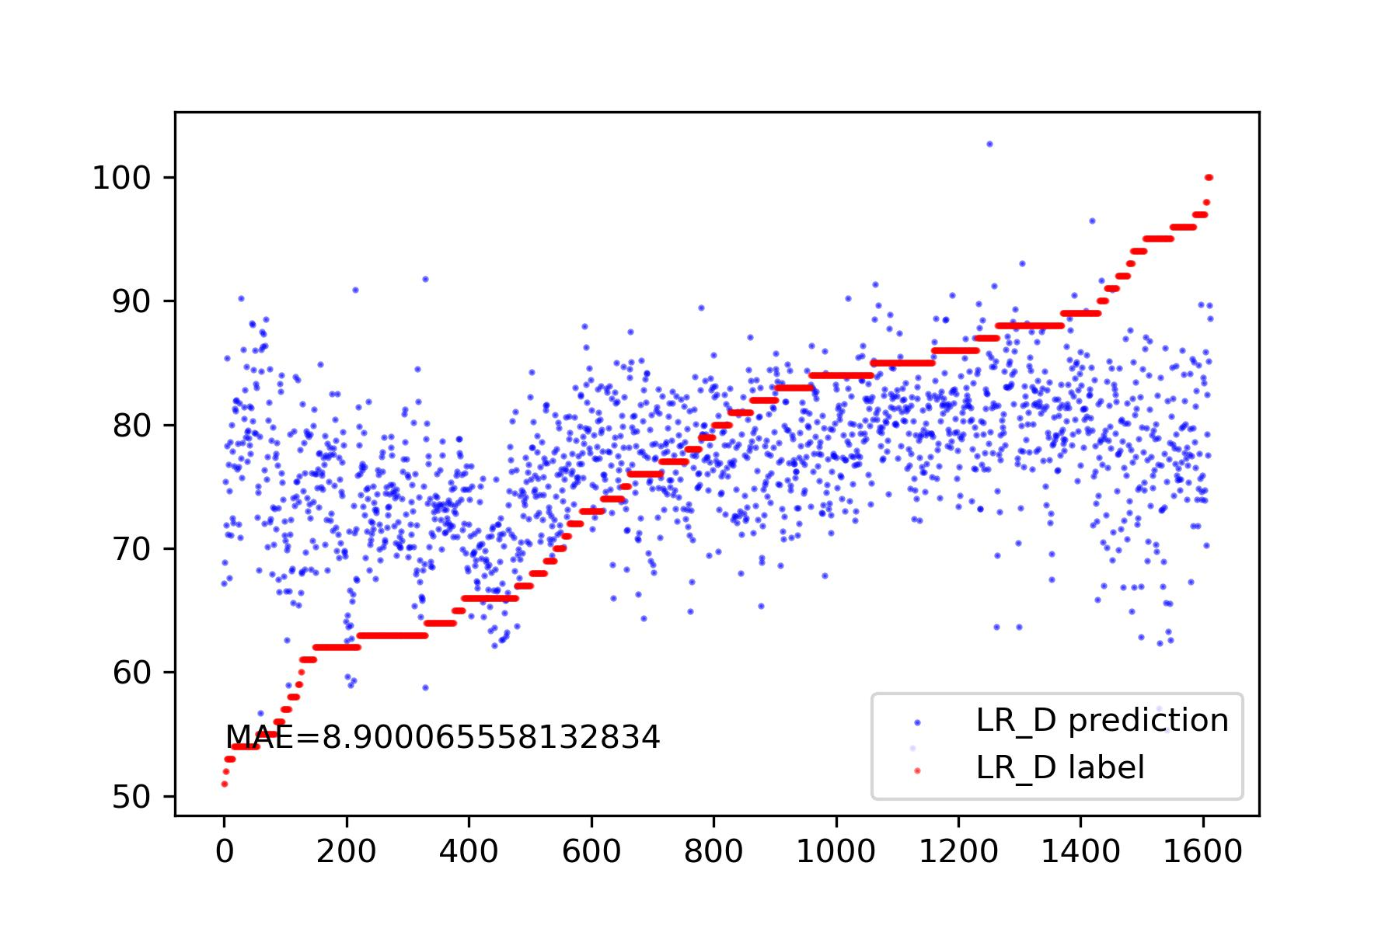
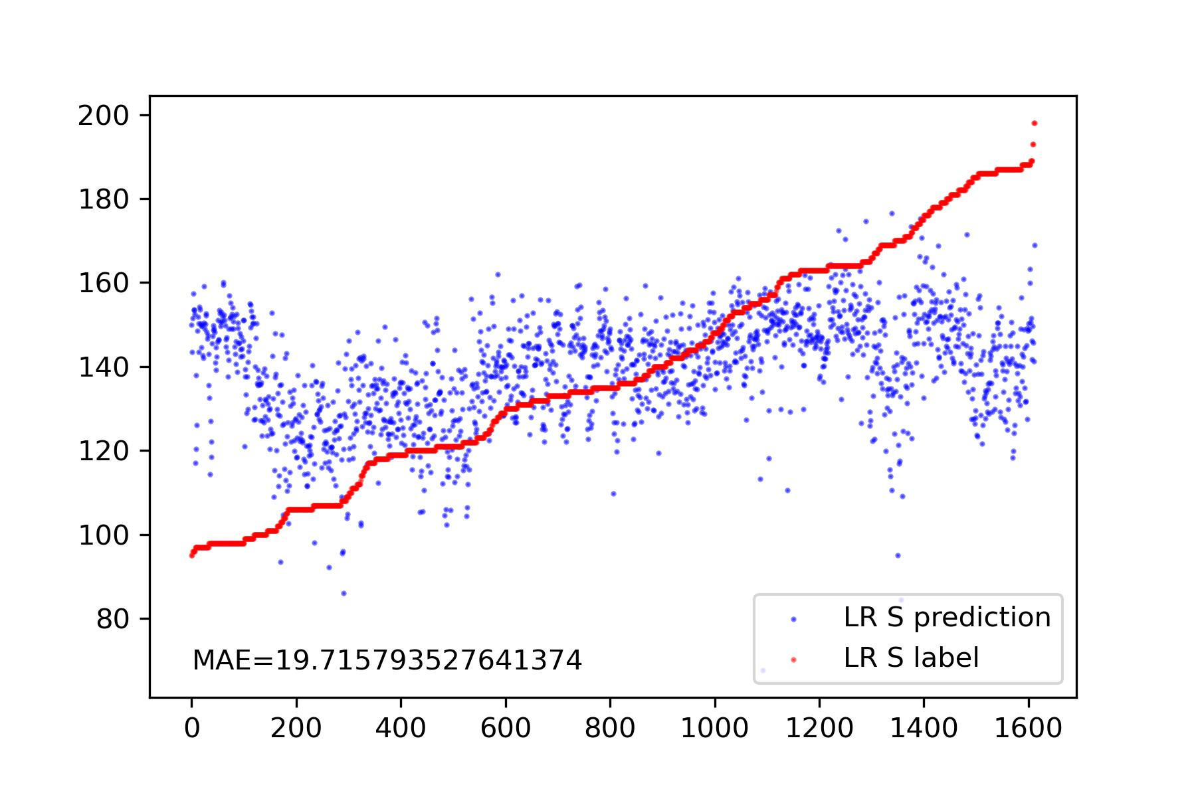
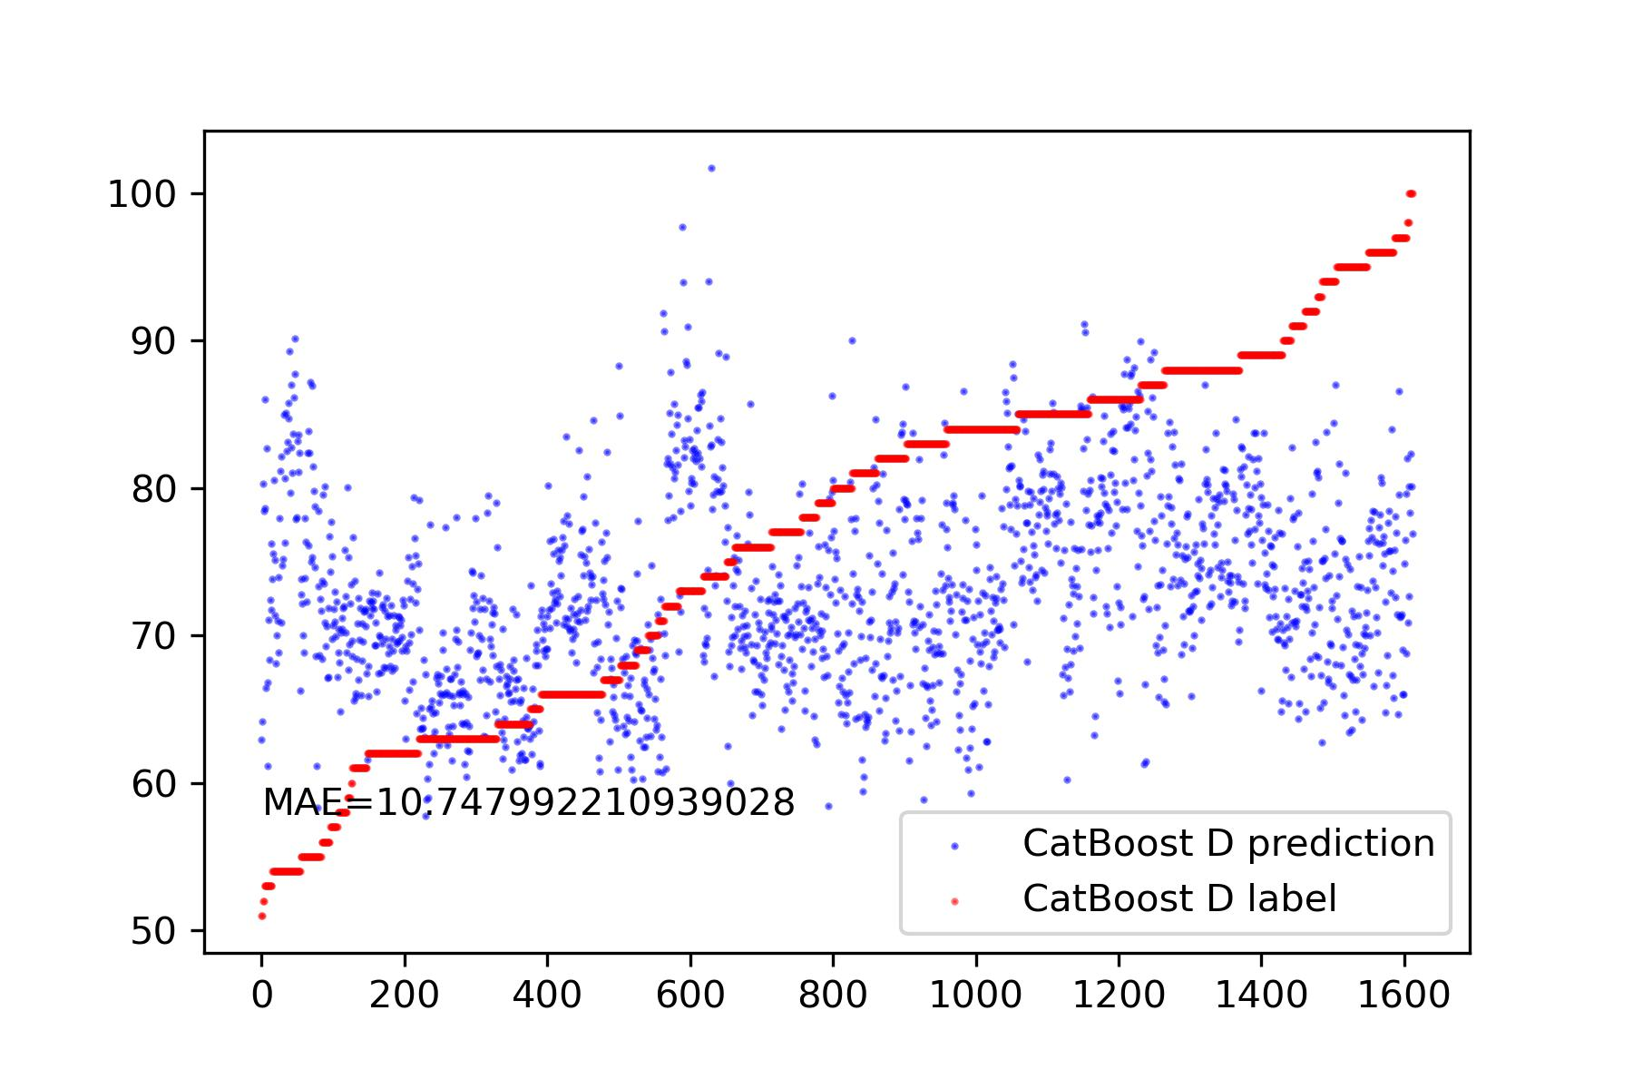
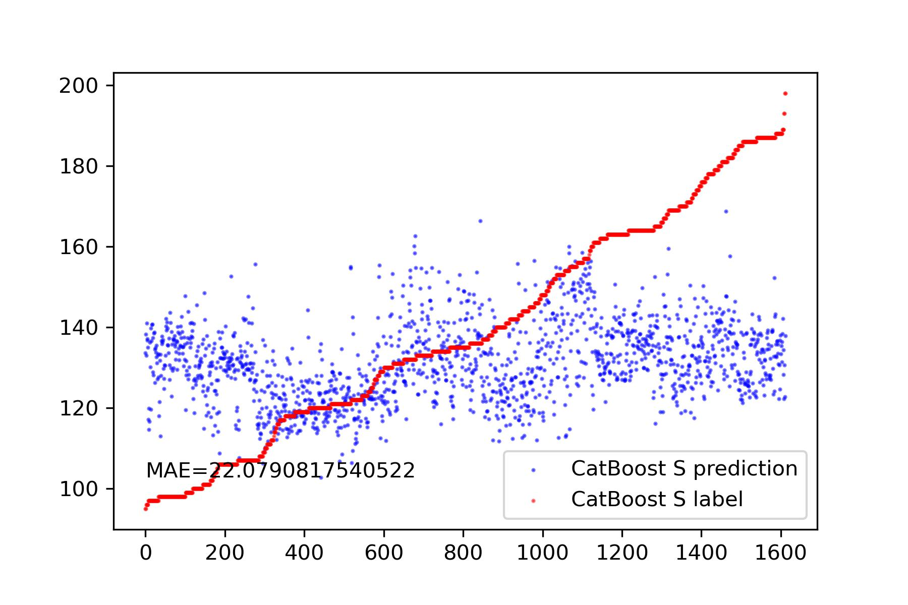
Feature Extraction
Preprocessing
Segmentation
Realignment
Template
Feature Extraction
Prediction
Feature cleaning
Drop NaN
Drop features with very small variance.
Drop features with a correlation lower than 0.2.
Linear Regression
Utilize Tsfresh to extract over 800 features from the template.
CatBoost
Linear Regression
CatBoost

Slide 14
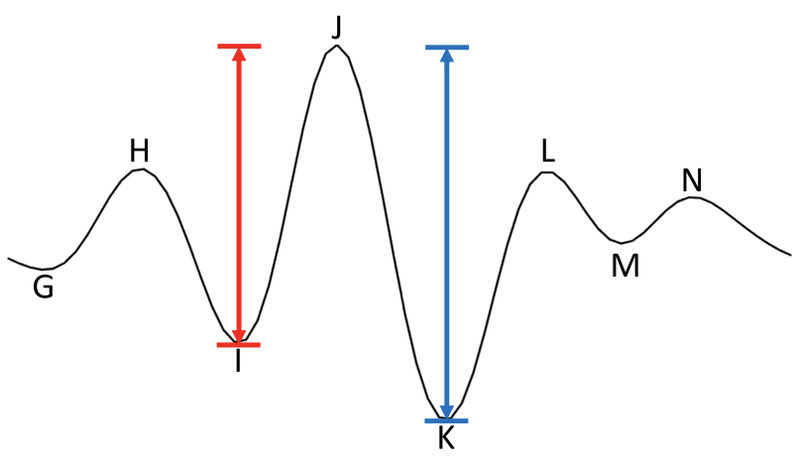
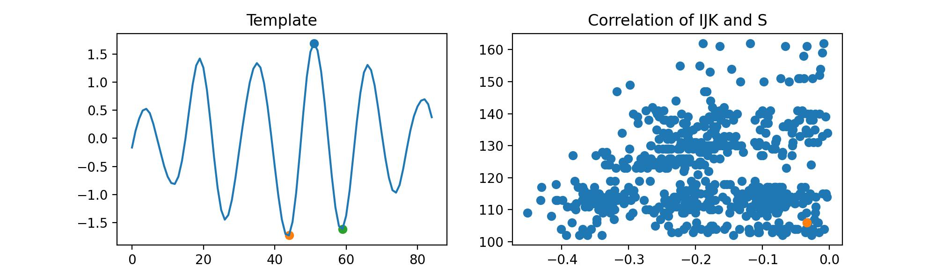
Feature Extraction
Preprocessing
Segmentation
Realignment
Template
Feature Extraction
Prediction
特征提取
IJK
以最大的峰为J峰
I和K峰的相对高度有问题
这种结构，似乎并不在所有的信号中存在

Slide 15
Feature Extraction
Preprocessing
Segmentation
Realignment
Template
Feature Extraction
Prediction
特征提取
IJK
几乎在所有的信号中存在

Slide 16
Part_3

Slide 17
An easy experiment about sampling rate.
The impact of different sampling rates on time series alignment.
Model | Data | Sampling Rate | Resample Method | S | D
Template: Mean | Simulation | 100 | - | 1.35 | 4.53
Template: Mean | Simulation | 100->150 | FFT | 0.95 | 3.24
Template: Mean | Simulation | 100->150 | POLY | 0.95 | 2.98
Template: Mean | Simulation | 150 | - | 0.92 | 2.36
Model | Data | Sampling Rate | Resample Method | S | D
Template: Mean | Simulation | 100 | - | 1.35 | 4.53
Template: Mean | Simulation | 100->200 | FFT | 0.70 | 2.47
Template: Mean | Simulation | 100->200 | POLY | 0.64 | 2.07
Template: Mean | Simulation | 200 | - | 0.65 | 1.75
Conclusion:
Resampling signals with low sampling rates can significantly improve the performance. Within a certain range, a higher sampling rate is better.
The resampling mode has a significant impact on the results, with FFT and POLY yielding completely different effects.

Slide 18
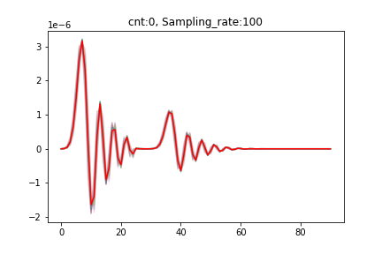
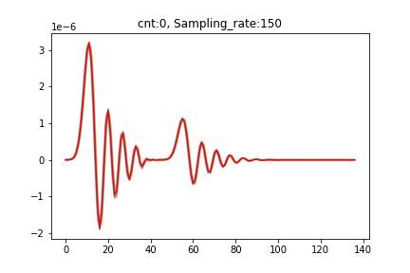

An easy experiment about sampling rate.
Principle of accuracy improvement
With the increase in sampling rate, originally relatively separated peaks gradually come closer together.
In addition, the more the number of time points, the higher the fault tolerance.
So the error decreases.
Resample
Low Sampling Rate
High Sampling Rate

Slide 19
Part_4

Slide 20
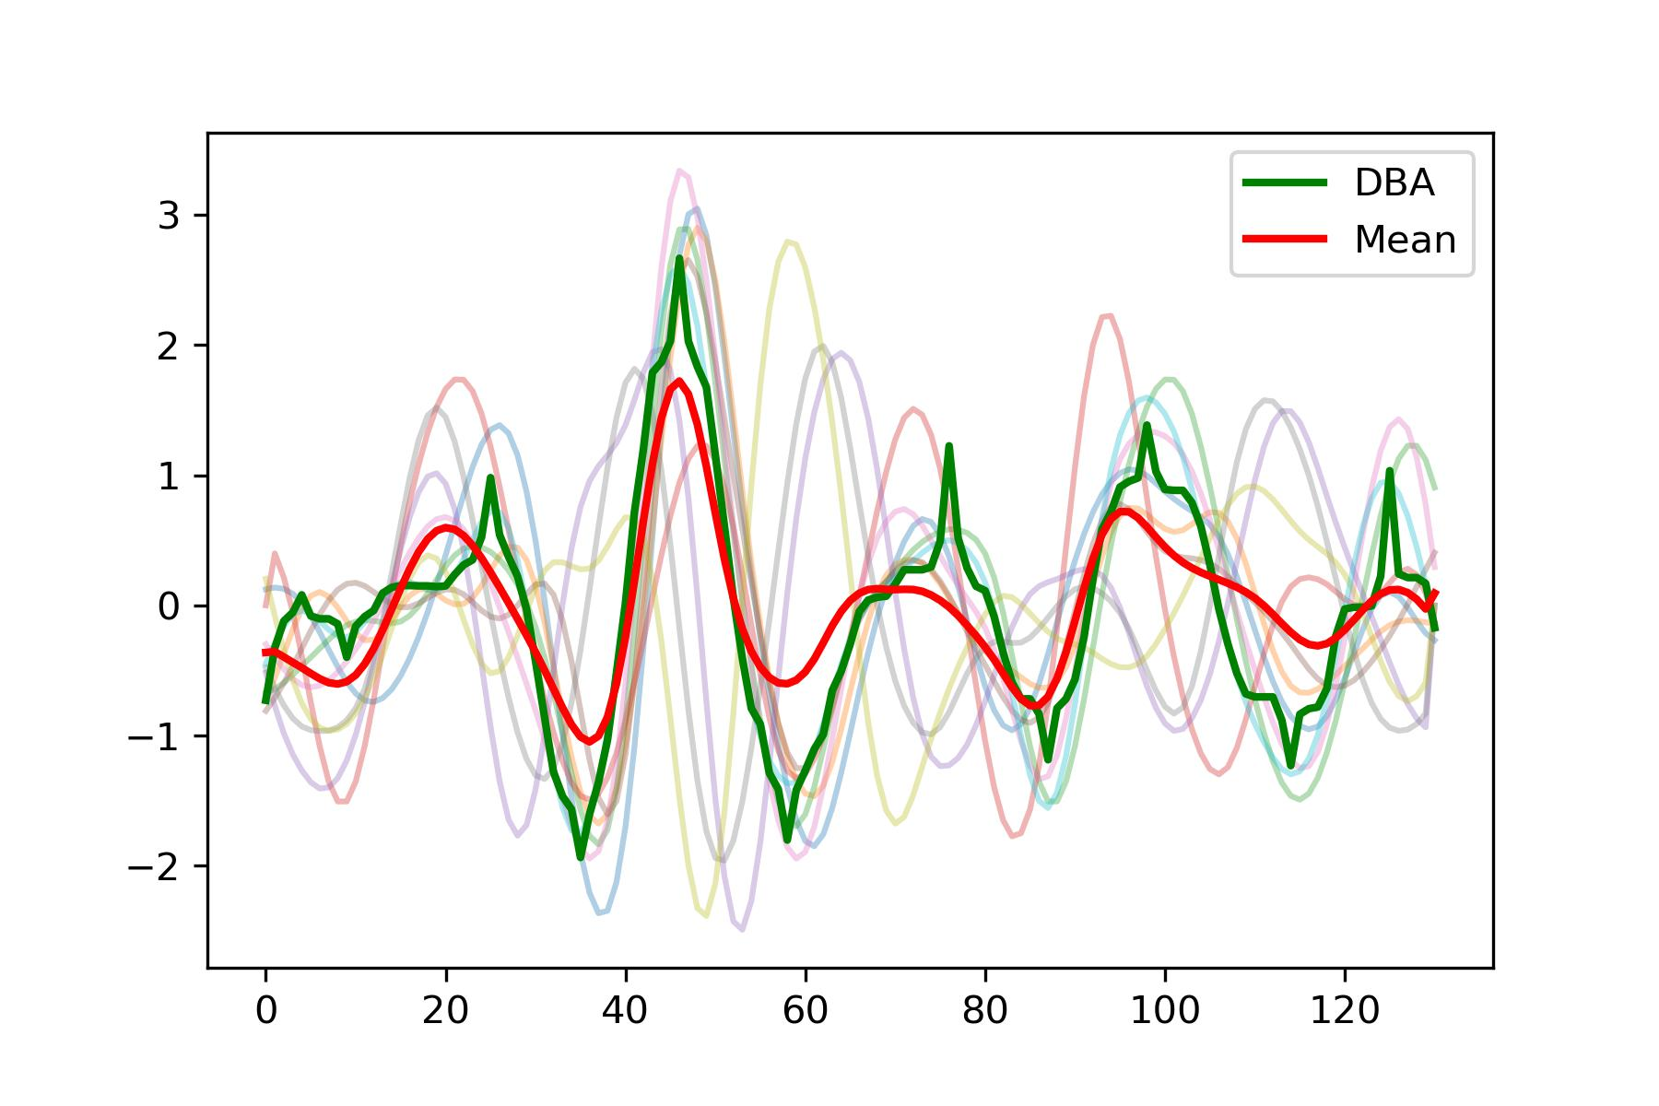
Cut, realign, and extract templates from real signals.
Signal quality:
For heart rate calculation, the previous filtering algorithm has performed well. However, for template extraction and feature analysis, it is not sufficient and requires an additional filtering layer.
The quality of the signal is in a critical state.
It is possible to extract a template that is barely satisfactory.

Slide 21
Part_5

Slide 22
Questions
If we want to precisely understand the BedDot BSG signal, do we need to simultaneously measure a person's SCG, BCG, and BSG signals to explore the relationships between these three signals? Are there any papers that have simultaneously measured SCG and BCG signals? I haven't found relevant papers.
If I were able to propose a segmentation, re-alignment, and innovate an effective template calculation method (with MAE < 3 on SCG simulated signals), and suggest a metric for evaluation, in what field would this likely be presented at a conference?

Slide 23
Thanks!

Slide 24
Why doesn’t FMM work
Advantages of FMM (from emails by authors):
“particularly when dealing with pronounced spike waves”
“The FMM model is specifically effective at identifying high peaks against the background noise”
“to detect other less prominent peaks more components could be added.”
Disadvantages of FMM (from the demo code):
We must decompose a single-cycle signal into a large number of components, if we want to focus on smaller peaks.
After decomposition, the relationship between these components becomes chaotic. There is a loss of interpretability in decomposed components.
We can only use FMM to denoise one-circle signal.

Slide 25
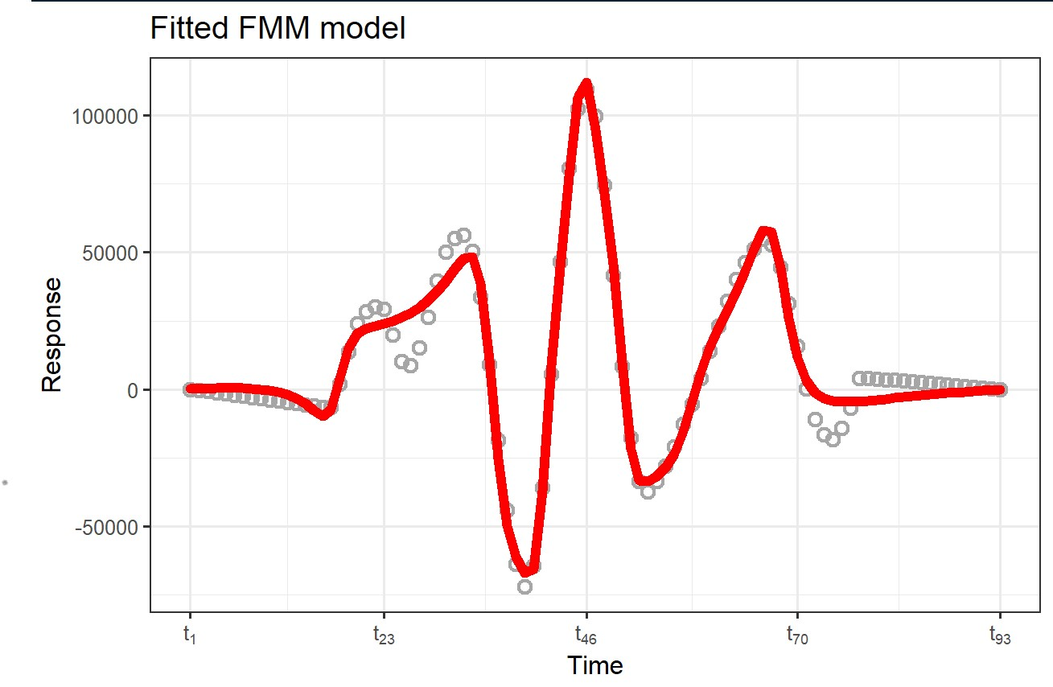
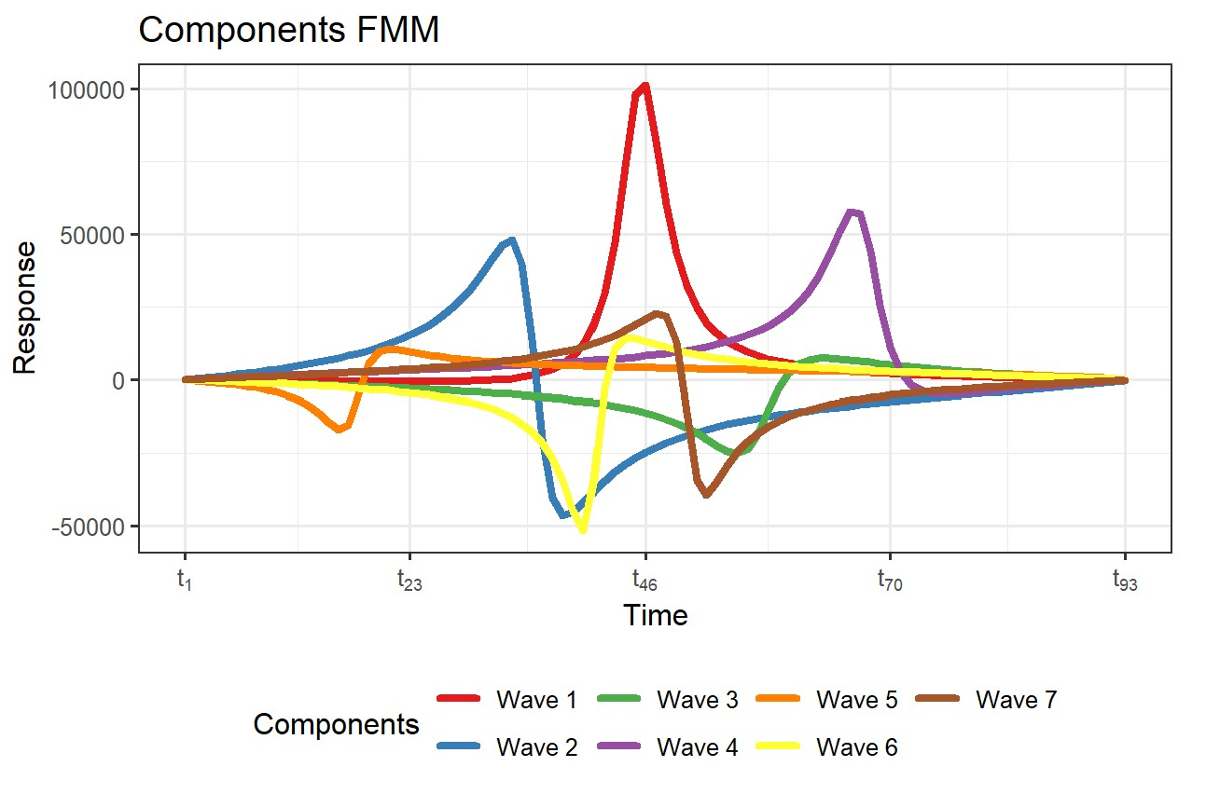
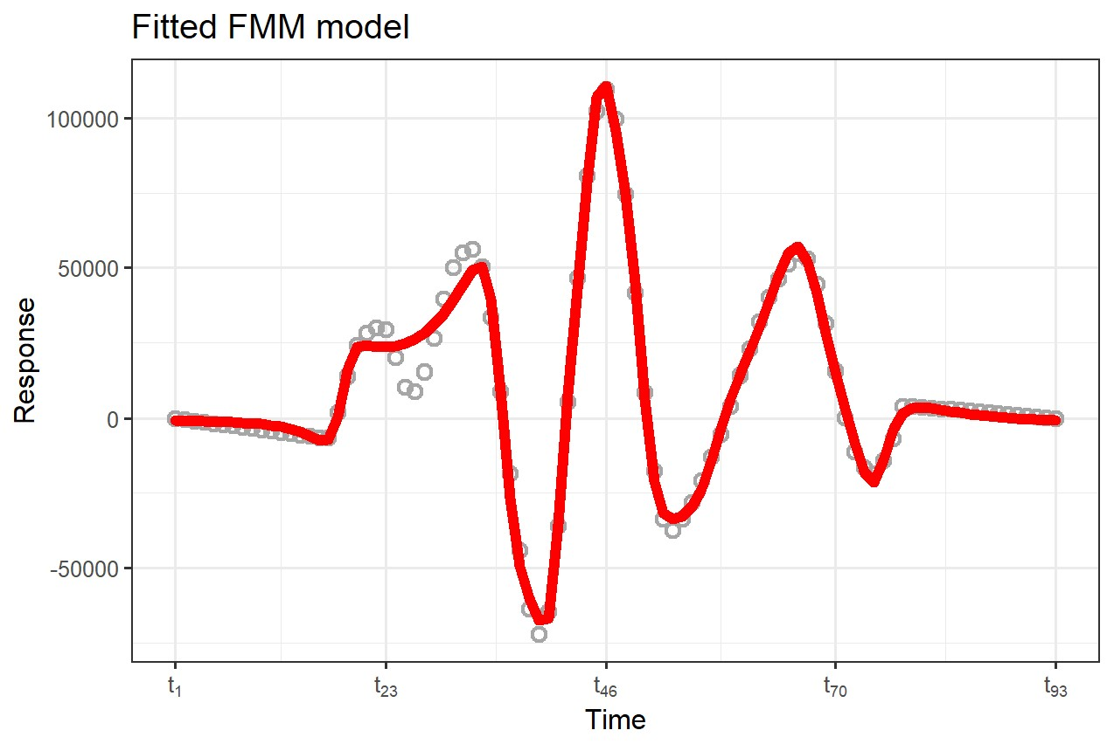
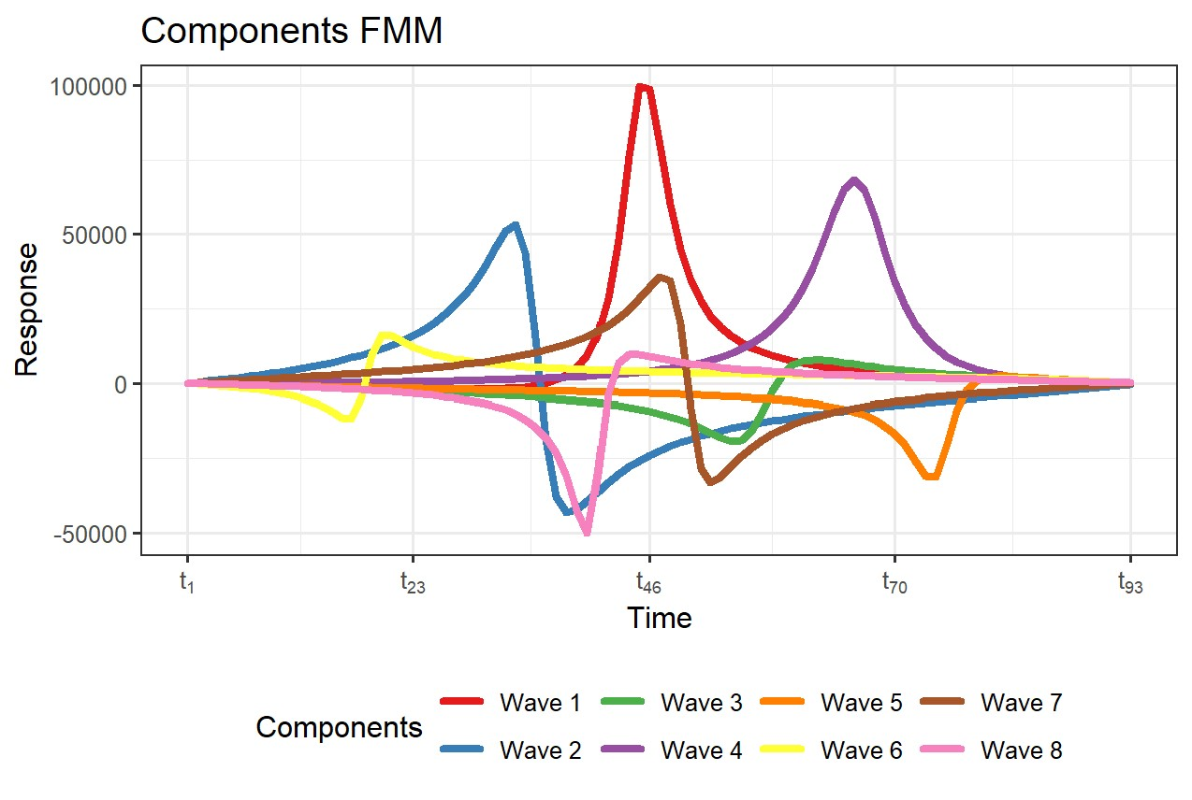
Why doesn’t FMM work
There is almost no interpretability in decomposed components.
We need to decompose a single-cycle signal into a large number of components, if we want to focus on smaller peaks.

